Slide 1
BB2920: Genetics
Prof. Farny
Lecture 3
1/17/17
Wednesday conference with your PLAs, HL116. Problem solving session, and also a chance to get help on your PS1
Thursday Help Session – 7-9pm in SL lounge area
Friday Office Hours - 11a-12:30p GH203C
Register those clickers!!!

Slide 2
Some notes about the reading quizzes:
Readings and Keywords are posted under Modules
Genetics has its own language – now you know what I mean! You need to be exposed several times and in several ways
If the first time you hear these words is during lecture, then you won’t be able to complete the Break-Outs effectively
I expect you will still have questions after you read – the quiz helps me know where those questions are
Use your books! Google stuff! Help each other (within reason…)!

Slide 3
Today’s Learning Objectives
Use your understanding of the molecular and chemical structure of DNA to calculate the features of a given DNA sample
Describe the nature and structure of chromatin
Understand the mechanism of DNA replication
Analyze a sequence and understand how replication will proceed for that sequence

Slide 4
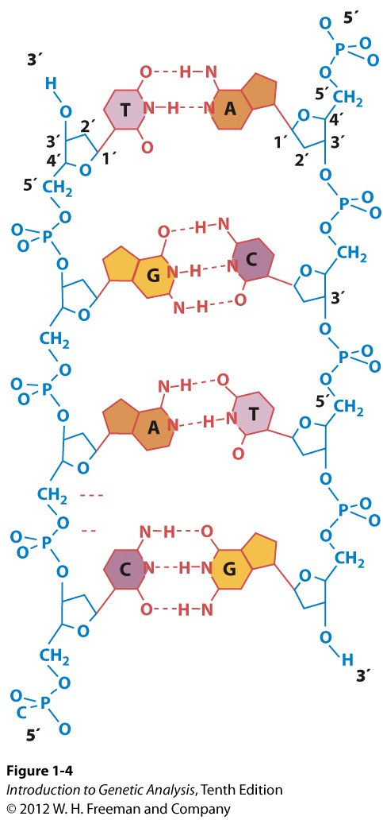
Important features of DNA structure that will help you understand replication– Learn these now!
5’→ 3’ linkage – nucleotides can ONLY be added to 3’!
Antiparallel – strands run in opposite directions
Complementary: Chargaff’s rules, A=T, G=C, Pyrimidine = purine (T+C = A+G)

Slide 5
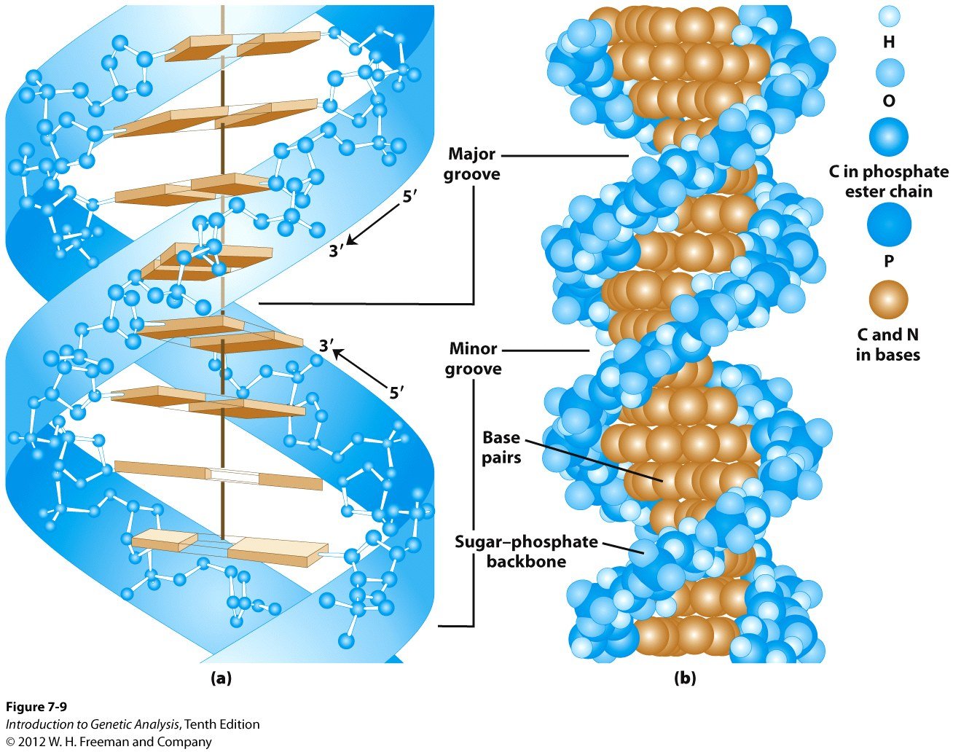
DNA is a double helix

Slide 6
Break-Out!

Slide 7
Working with base pairing: A 1kb (kilobase, 1000 base pair) segment of DNA is 22% adenine.
How many total guanine nucleotides are present? (Hint: remember that each base pair consists of TWO nucleotides)
How many total hydrogen bonds connect the two strands?
Which strand has more A nucleotides: the 3’ strand, the 5’ strand, or are they equal? (Hint: how can you tell??)

Slide 8
A 1kb (1000 base pair) segment of DNA is 22% adenine. How many total guanine nucleotides are present? (HINT: remember each base pair is made up of TWO nucleotides)
560
440
280
220
140

Slide 9
One base pair = 2 nt
1000 bp = 2000 total nucleotides present
22%A = 440 nt
A=T, so 44% are A or T (880 nt)
That leaves 56% C and G = 1120nt,
G = C, so 56%/2 = 28%
28% = C = 560nt
And 28% = G = 560nt

Slide 10
A 1kb (1000 base pair) segment of DNA is 22% adenine. How many total hydrogen bonds join the two strands?
Rank | Responses
1 | 2560
2 | 1280
3 | 5120
4 | 1680
5 | 2120
6 | Other
Values: 2560
Value Matches: 42

Slide 11
1000 bp
440 are A-T x 2 bonds = 880
560 are C-G x 3 bonds = 1680
Total = 2560

Slide 12

A 1kb (1000 base pair) segment of DNA is 22% adenine. Which strand has more A nucleotides. (Hint: how can you tell??)
The 5’ strand has more As
The 3’ strand has more As
The As are equally distributed between the 5’ and 3’ strands
There is not enough information to determine the composition of each strand

Slide 13
5’
T T A A G C G A A A A T T C G C C A
A A T T C G C T T T T A A G C G G T
11 of 18 (61%) are A/T pairs
11/36 (30.5%) of total nucleotides are A
7 As on 5’ strand
3’
5’
T T T T G C G T T T T T T C G C C T
A A A A C G C A A A A A A G C G G A
11 of 18 (61%) are A/T pairs
11/36 (30.5%) of total nucleotides are A
0 As on 5’ strand
3’

Slide 14
Important features of DNA structure that will help you understand replication– Learn these now!
5’→ 3’ linkage – nucleotides can ONLY be added to 3’!
Antiparallel – strands run in opposite directions
Complementary: Chargaff’s rules, A=T, G=C, Pyrimidine = purine (T+C = A+G)
But T+A = C+G !
5’ GGCCGGCC
3’ CCGGCCGG

Slide 15
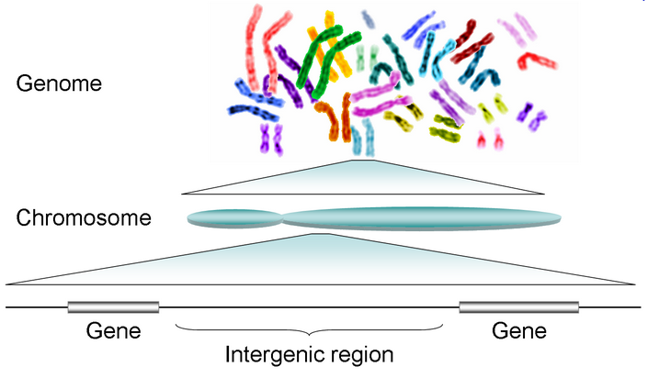

DNA, in the form of chromosomes, is the inherited genetic material
one complete copy of all the DNA of an organism
DNA

Slide 16
How many total chromosomes are in a typical human cell?
12
23
46
58
I have no idea!

Slide 17
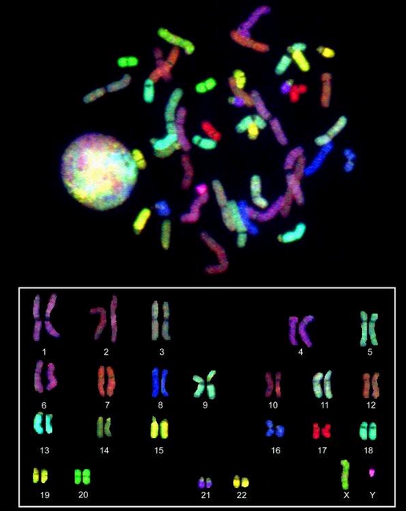
Chromosomes are the basis of heredity
A human karyotype
Ploidy – number of genome copies
Diploid: 2 copies of each chromosome
2n (n=number of individual chromosomes)
Haploid: 1 copy of each chromosome
1n (or just n)
Humans?
n = 23, 2n = 46
22 pairs autosomes
1 pair sex chromosome
Human Genome Research Institute (genome.gov)
Pairs are called homologous chromosomes
Notes:
notice, homologous pairs are not necessarily next to each other in the cell, They will pair during cell division (mitosis or meiosis)

Slide 18
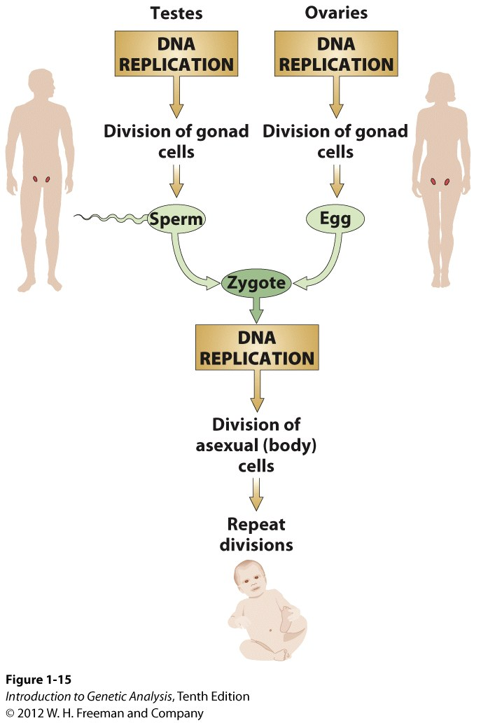
Chromosomes are the “units” of heredity
1n = 23, 2n = 46
22 autosomes
1 sex chromosome
Somatic cells (all non-gametes) are diploid, 2n
- Mitosis
Gametes (reproductive cells) are haploid, n
- Meiosis
Notes:
Why are human gametes haploid?

Slide 19
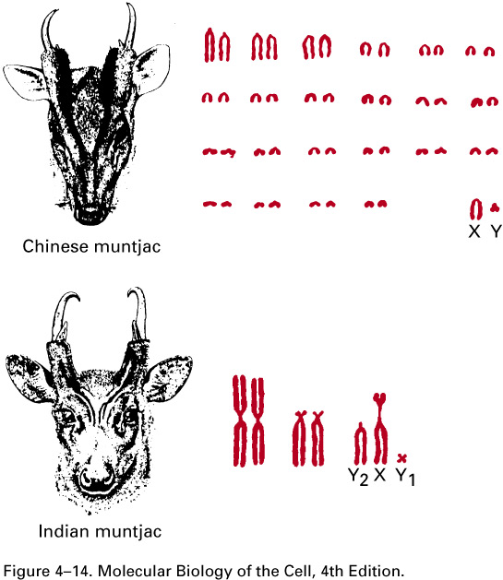
Different species have different complements of chromosomes
Species | n =
Pea | 7
Kangaroo | 8
Honey Bee | 16
Human | 23
Turkey | 40
Carp | 52
Adders-tongue fern | 720
2n=32
2n=4
# of chromosomes complexity!!

Slide 20
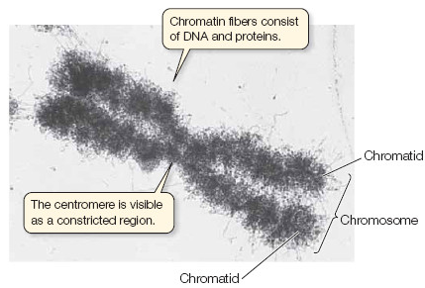
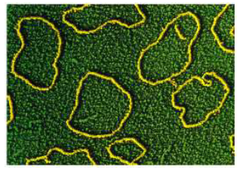
Chromosome Structure
1 human genome = 1 meter
typical cell nucleus = 5-20 μm
DNA must be condensed and packaged in order to fit in the nucleus
DNA + associated proteins = chromatin
Prokaryotic:
circular
Eukaryotic:
linear
centromere = center
telomere = ends

Slide 21
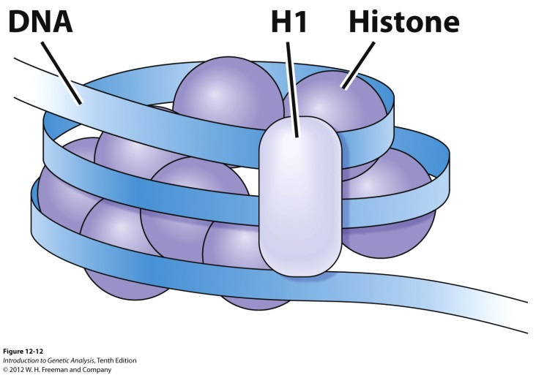
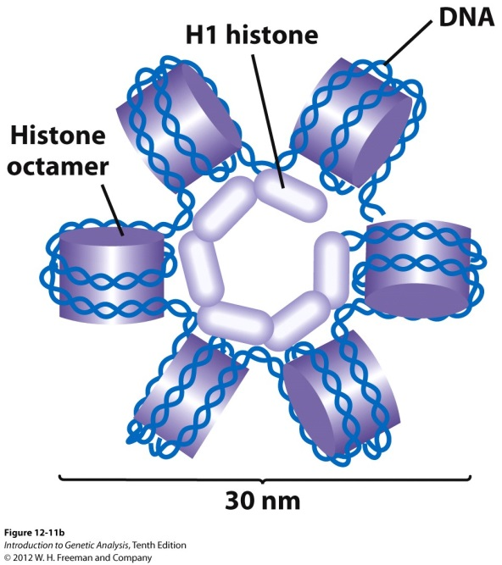
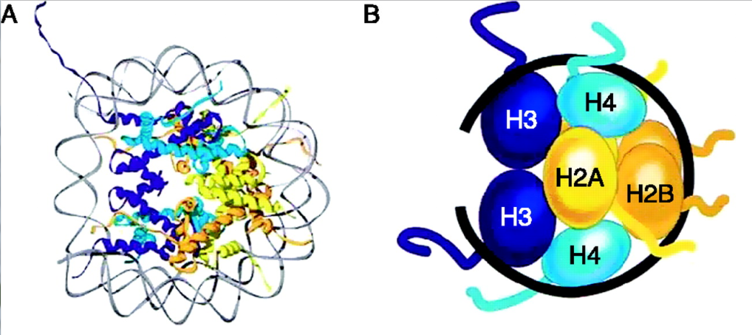
DNA is wound around protein “spools”
called nucleosomes
Histones: protein components of chromatin
Octamer, 2 each, H2A, H2B, H3, H4
H1 = nucleosome linker, folds nucleosomes into 30nm fiber
~146 bp of DNA per nucleosome (contacting the core proteins)

Slide 22
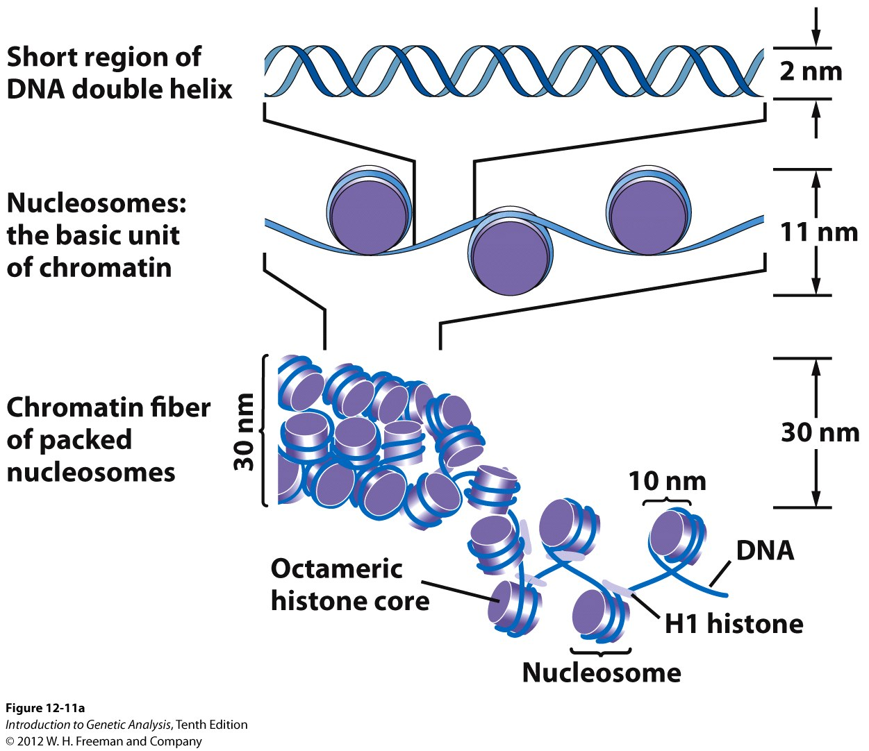
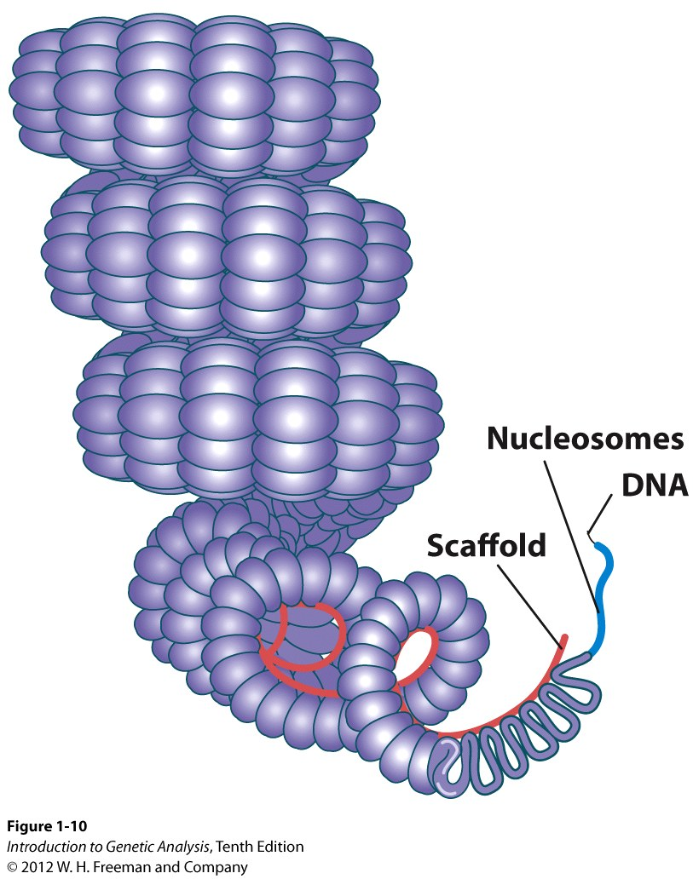
Multiple levels of coiling further condenses the chromatin

Slide 23
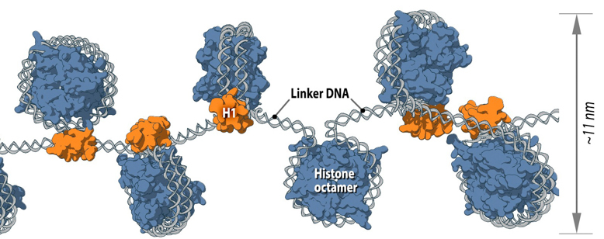
Approximately how much DNA is shown in this figure?
About 100bp
About 1000bp
About 100kb
About a 1000kb
It is impossible to say

Slide 24
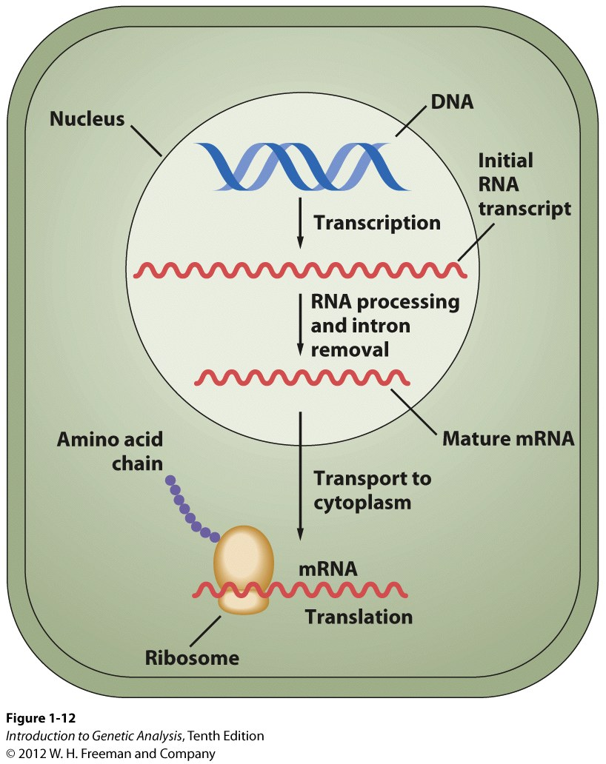
The Central Dogma of Molecular Biology
DNA
transcription
RNA
translation
Protein
replication

Slide 25
Important features of DNA structure that will help you understand replication
5’→ 3’ linkage – nucleotides can ONLY be added to 3’!
Antiparallel – strands run in opposite directions
Complementary: Chargaff’s rules, A=T, G=C, Pyrimidine = purine (T+C = A+G)
But T+A = C+G !
5’ GGCCGGCC
3’ CCGGCCGG

Slide 26
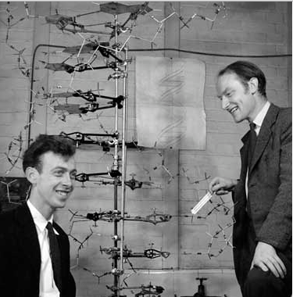
Understatement of the millennium:
“It has not escaped our notice that the specific pairing we have postulated immediately suggests a possible copying mechanism for the genetic material.” – Watson and Crick (1953)

Slide 27
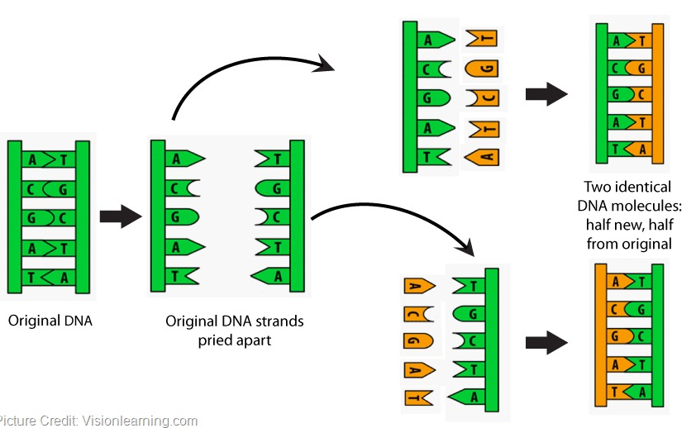
DNA Replication
“It has not escaped our notice that the specific pairing we have postulated immediately suggests a possible copying mechanism for the genetic material.” – Watson and Crick

Slide 28
DNA Replication
http://www.hhmi.org/biointeractive/dna-replication-advanced-detail

Slide 29
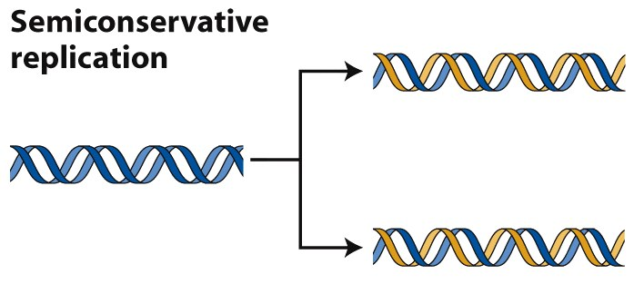
DNA Replication
“It has not escaped our notice that the specific pairing we have postulated immediately suggests a possible copying mechanism for the genetic material.” – Watson and Crick
Problems:
Where do you start?
How do you separate the two strands?
How is the copy of each strand made?

Slide 30
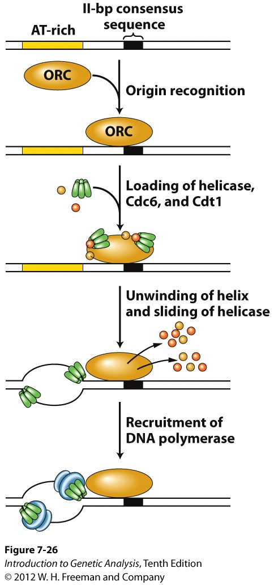
DNA replication
Challenge 1: where to begin?
Origin of Replication (or just “origin”)
a sequence element recognized by a protein complex, marks the place that DNA replication should start
Protein complex brings unwinding enzymes called helicases that begin to unwind the strands
E. coli – 1 origin
Yeast - ~400 origins
Humans – thousands and thousands
Notes:
In order to make a copy, you need to separate the strands. How is this done?

Slide 31
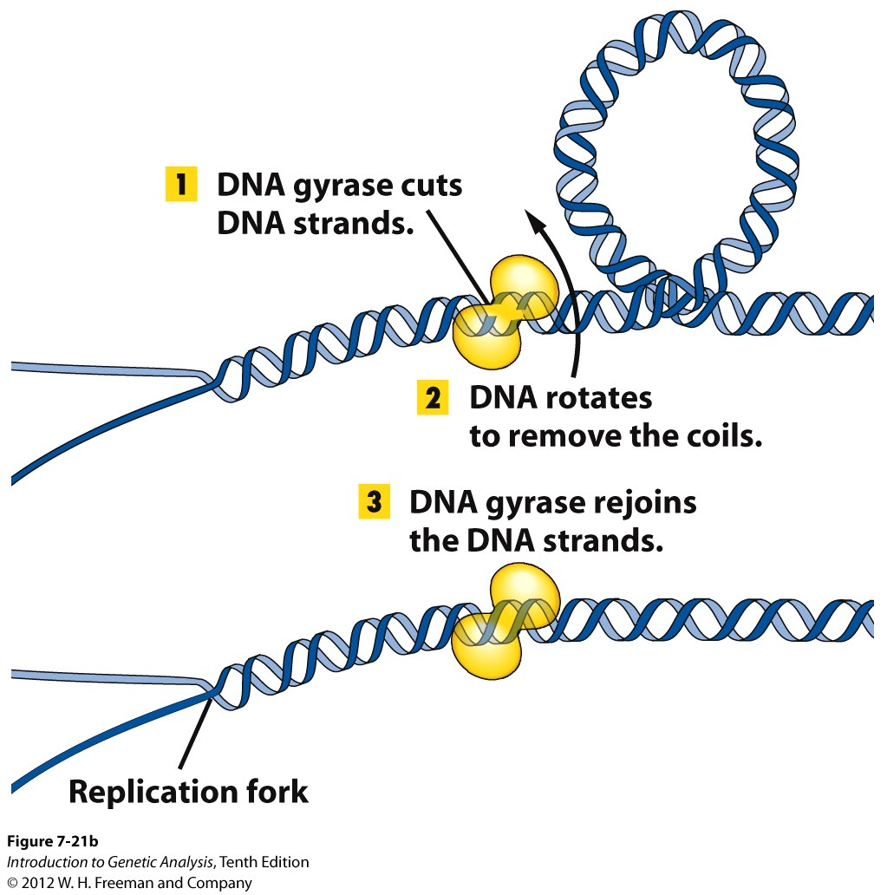
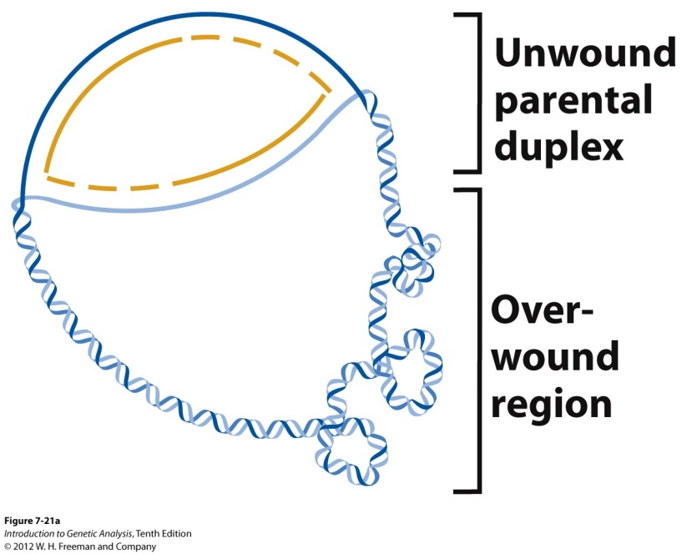
DNA replication
Challenge 2: Unwinding a double helix
Helicase
replication forks
Gyrase and topoisomerase are the same. Topoisomerase is a type of gyrase.
Gyrase and helicase are NOT the same. Gyrase relieves supercoiling, Helicase separates strands by disrupting hydrogen bonds.

Slide 32
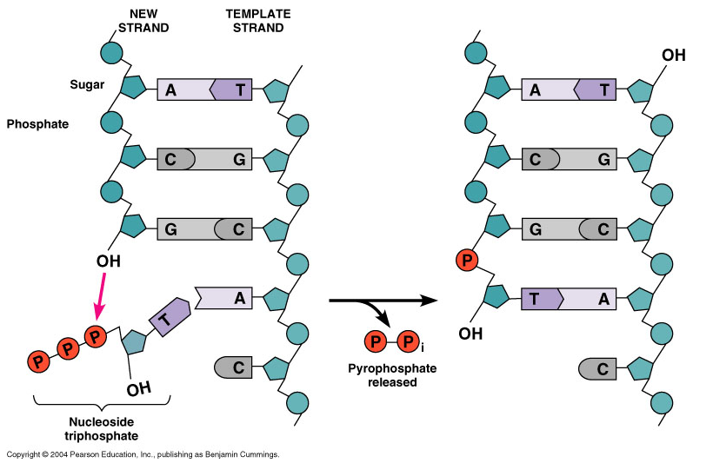
DNA replication
Challenge 3: what is the copying enzyme?
DNA polymerase III
creates a polymer (strand) of DNA by catalyzing the hydrolysis of nucleoside triphosphates (ATP, CTP, GTP, TTP) to form a phosphodiester bond
can only join to the 3’ end of an existing chain
3’ → 5’ exonuclease activity, “proofreading”
Problems?
what if there is not an existing chain?
how does it synthesize the other strand (away from the replication fork?)

Slide 33
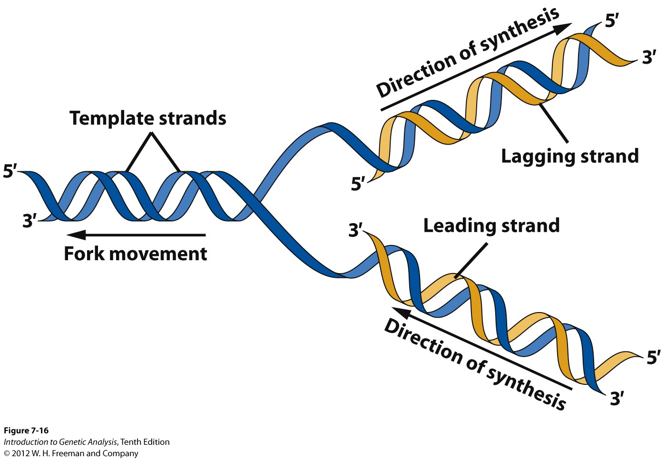
Challenge 4: how does the polymerase synthesize the other strand (away from the replication fork?)
Template strand is READ: 3’ → 5’
New DNA is SYNTHESIZED: 5’ → 3’
AGAIN: free nucleotides, RNA OR DNA, can only be joined to an open 3’ end!!
AND, base pairing is ALWAYS antiparallel. You’ll be able to figure it out if you remember that these rules must ALWAYS apply!

Slide 34
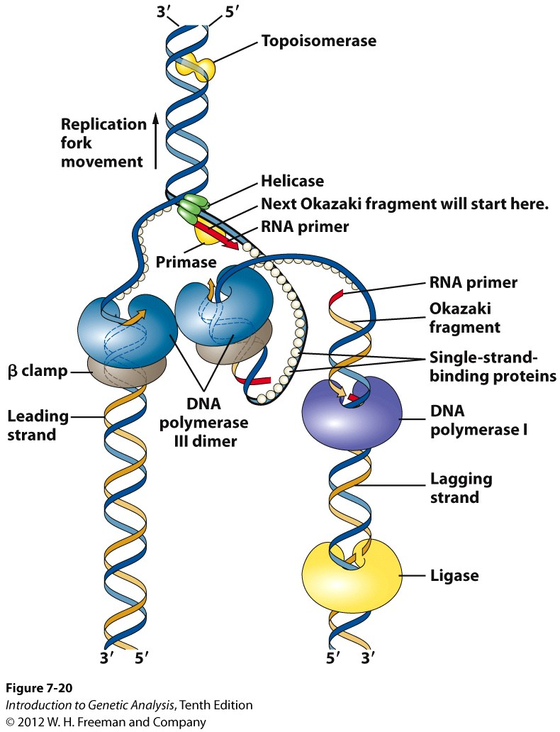
Proteins at work at the replication fork
(=gyrase)
Helicases: open and unwind DNA
Gyrases: relieve over-winding
Single-stranded binding proteins: coat the separated DNA to keep it separated
Primase: creates a short bit (8-12 nt) of complementary RNA “primer” which DNA Pol III can use to begin DNA synthesis
On the Leading strand: DNA Pol III immediately follows the replication fork
β clamp: holds the Pol III on the DNA
DNA polymerase I: removes the RNA primer, fills in the space with DNA
Ligase: glues the DNA ends together (where the primer used to be and the start of the Pol III strand, at the origin)

Slide 35
Proteins at work at the replication fork
On the Lagging strand:
Primase makes an RNA primer close to the replication fork
DNA Pol III: extends the primer until it hits the end of another new fragment of DNA. These short bits of new DNA are called Okazaki fragments.
DNA Pol I: removes the RNA primer and fills in the DNA between fragments.
Ligase: glues the two ends together.
DNA replication is:
Fast! 1000 nt/sec
Faithful! high fidelity, only 1 in 10¹⁰ errors

